Slide 1
CN Tutorial-7
Aman Sharma and Shambhavi Pathak

Slide 2
Topics to be covered
1)TCP Congestion
2)TCP Sawtooth Behavior

Slide 3
TCP Congestion
TCP congestion refers to a situation in a computer network where there is an excessive demand for network resources, leading to a degradation of performance.
This occurs when the amount of data being sent over a network surpasses its capacity to handle that data, resulting in delays, packet loss, and reduced throughput.
Congestion can happen at various points in a network, such as routers, switches, or links.

Slide 4
TCP Congestion Control
Congestion Window (CWND): TCP uses a congestion control mechanism to avoid overloading the network. The congestion window (CWND) is a key parameter that determines how much data can be in transit at any given time. It dynamically adjusts based on network conditions.
Slow Start and Congestion Avoidance: TCP uses a slow-start mechanism when a connection is initiated or after a timeout, gradually increasing the amount of data sent. Once a certain threshold is reached, it enters congestion avoidance mode, where the congestion window grows more slowly to prevent overloading the network.

Slide 5
TCP Congestion Control
Retransmission Timeout (RTO): If a TCP sender does not receive an acknowledgment for a sent packet within a certain time (RTO), it assumes the packet is lost and retransmits it. This mechanism helps deal with packet loss, which can be an indicator of congestion.
Fast Retransmit and Fast Recovery: If TCP detects three duplicate acknowledgments for the same packet, it assumes that the original packet was lost and performs a fast retransmit, resending the missing packet without waiting for the RTO. Fast recovery helps TCP to quickly regain its momentum after a fast retransmit.

Slide 6
TCP Sawtooth behavior
The TCP sawtooth behavior refers to the characteristic pattern observed in the congestion window size of a TCP connection over time.
This pattern resembles a sawtooth shape on a graph, hence the name.
The congestion window represents the number of unacknowledged packets that a sender can have in transit at any given time.

Slide 7
TCP Sawtooth behavior
Slow Start:
The sawtooth behavior begins with the slow start phase. In this phase, the sender starts by sending a few packets into the network. For every acknowledgment received, the sender doubles the size of its congestion window. This results in an exponential increase in the amount of data being sent.
Congestion Avoidance:
As the congestion window size grows, TCP transitions to the congestion avoidance phase. In this phase, the sender increases the congestion window more gradually, typically by adding one packet for every round-trip time. This helps to prevent the sender from flooding the network and causing congestion.

Slide 8
TCP Sawtooth behavior
Packet Loss and Reduction:
If TCP detects packet loss, which is often an indication of network congestion, it reacts by reducing the congestion window size. The sender interprets packet loss as a signal that the network capacity has been reached, and it needs to back off to alleviate congestion. This reduction in the congestion window is what gives the Sawtooth pattern its characteristic downward slope.
Fast Recovery:
Instead of immediately going back to a slow start after detecting packet loss, TCP uses a mechanism called fast recovery. When a sender receives three duplicate acknowledgments (indicating that a packet was likely lost), it assumes that the next packet in sequence was lost and retransmits it without waiting for a timeout. This helps TCP to quickly recover from the episode of congestion without fully returning to the slow start.

Slide 9
TCP Sawtooth behavior
Resume Growth:
After reducing the congestion window size due to packet loss, TCP resumes its growth in the congestion avoidance phase. The window size gradually increases until packet loss is detected again, at which point the cycle repeats.

Slide 10
TCP Sawtooth behavior
The sawtooth behavior is a fundamental part of TCP's congestion control algorithm. It allows TCP to adapt dynamically to network conditions, finding an optimal balance between utilizing available bandwidth and avoiding congestion.
This dynamic adjustment helps TCP maintain network stability and efficiency, making it a reliable protocol for data transmission over diverse and changing network environments.

Slide 11
Demonstration of TCP Sawtooth Behavior

Slide 12

Let’s see in action…..

Slide 13
ss command
utility to investigate sockets
It can display TCP and other socket state information.
flags that might be of our interest for the current task:
-e: show detailed socket information
-i: shows information about the domain sockets that match the specified criteria.
-n: Shows numerical addresses instead of resolving them to hostnames.

Slide 14
Shell Scripts involved in the experimental setup were related to the following tasks:
Collecting cwnd, a TCP state variable. (Why not from the packet header?)
Creating congestion in the network.
Let’s look at them

Slide 15
Python script to plot the graph b/w cwnd and time
Let’s have a quick look over it..

Slide 16
The Graph….

Slide 17
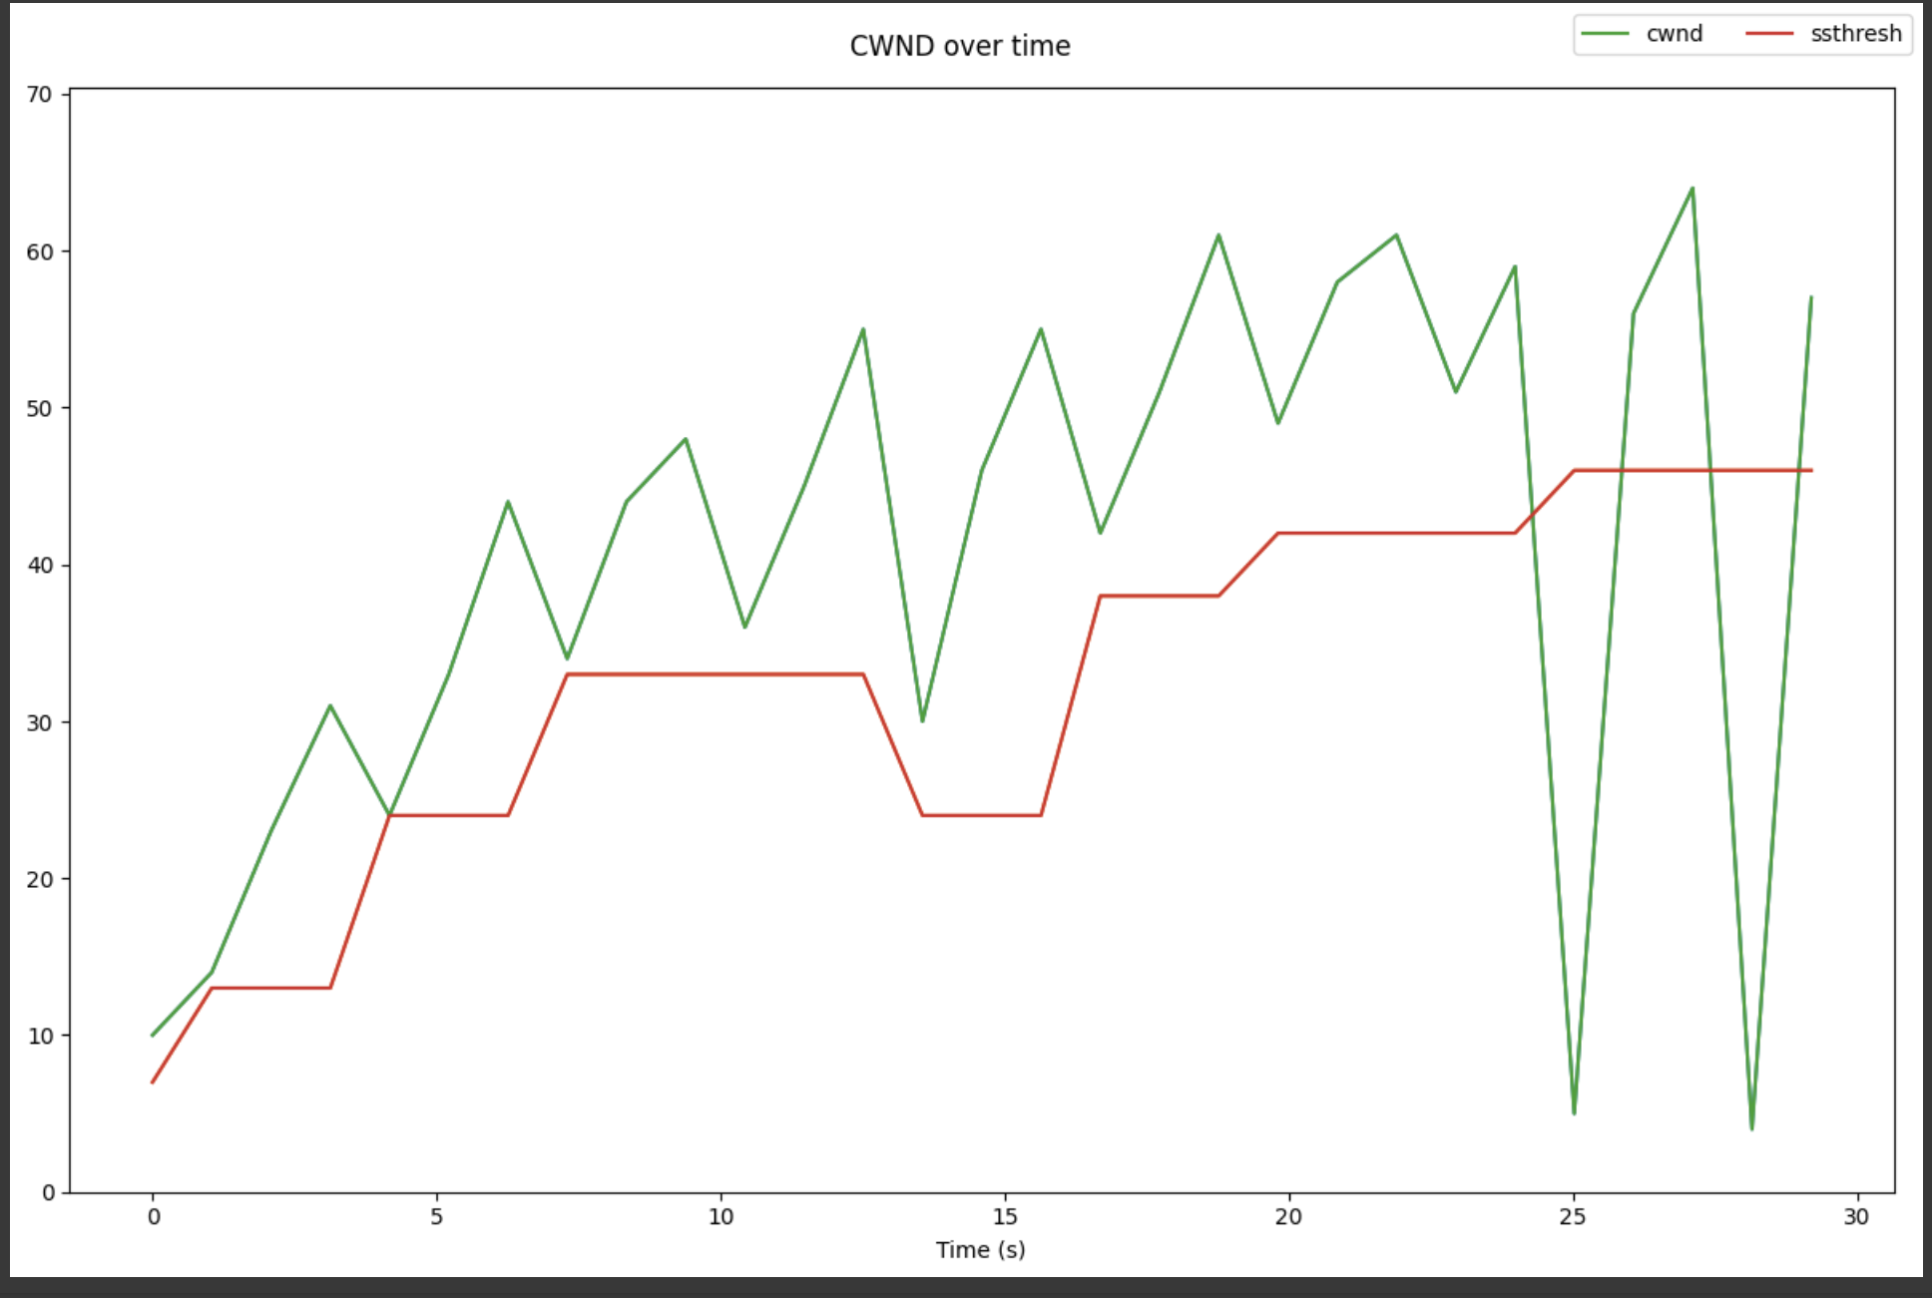

Slide 18
References
TCP Congestion Control - GeeksforGeeks
TCP congestion control - Wikipedia
TCP congestion control - witestlab.poly.edu (cwnd collection script, python plotting script)
TCP congestion control - RFC 5681

